Slide 1
Assignment 1.4
AI Chatbot Assistant Workflow Overview
Surgio (PocketDoc)

Slide 2
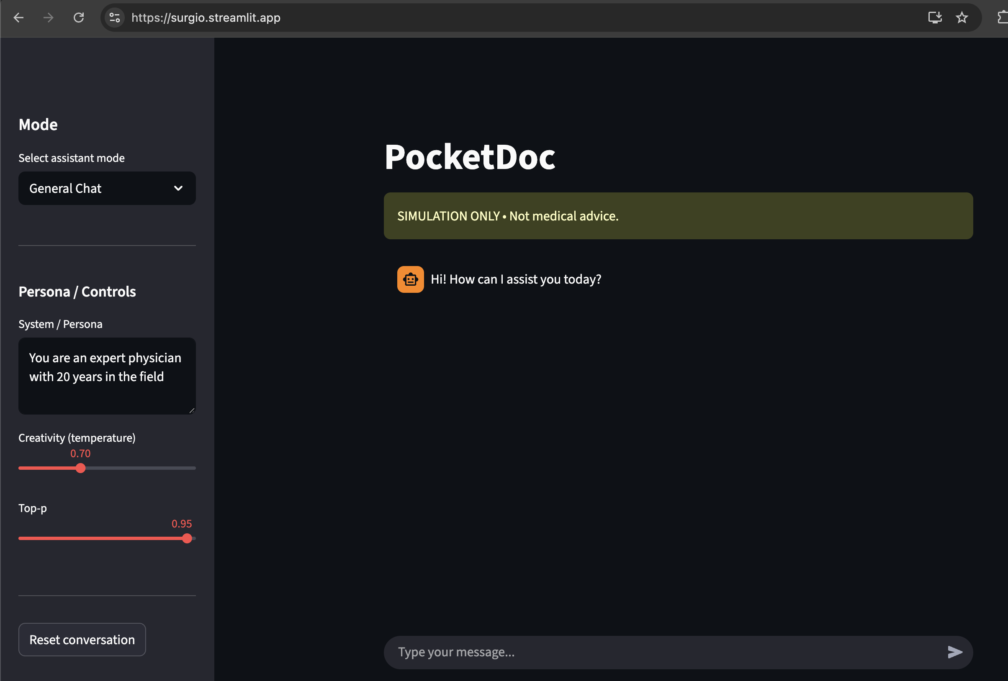
Surgio (PocketDoc)
Surgio (PocketDoc) is a Stream-lit based AI chatbot using Google’s Gemini API Key engineered to deliver critical information rapidly in high-stakes, fast-paced environments such as medical emergency rooms.
Comes in two modes
General Chat: Conversational medical expert.
ER Pre-Op Assistant (SIM): simulates a pre-operative readiness assistant that generates structured pre-op checklists based on uploaded synthetic patient records.

Slide 3
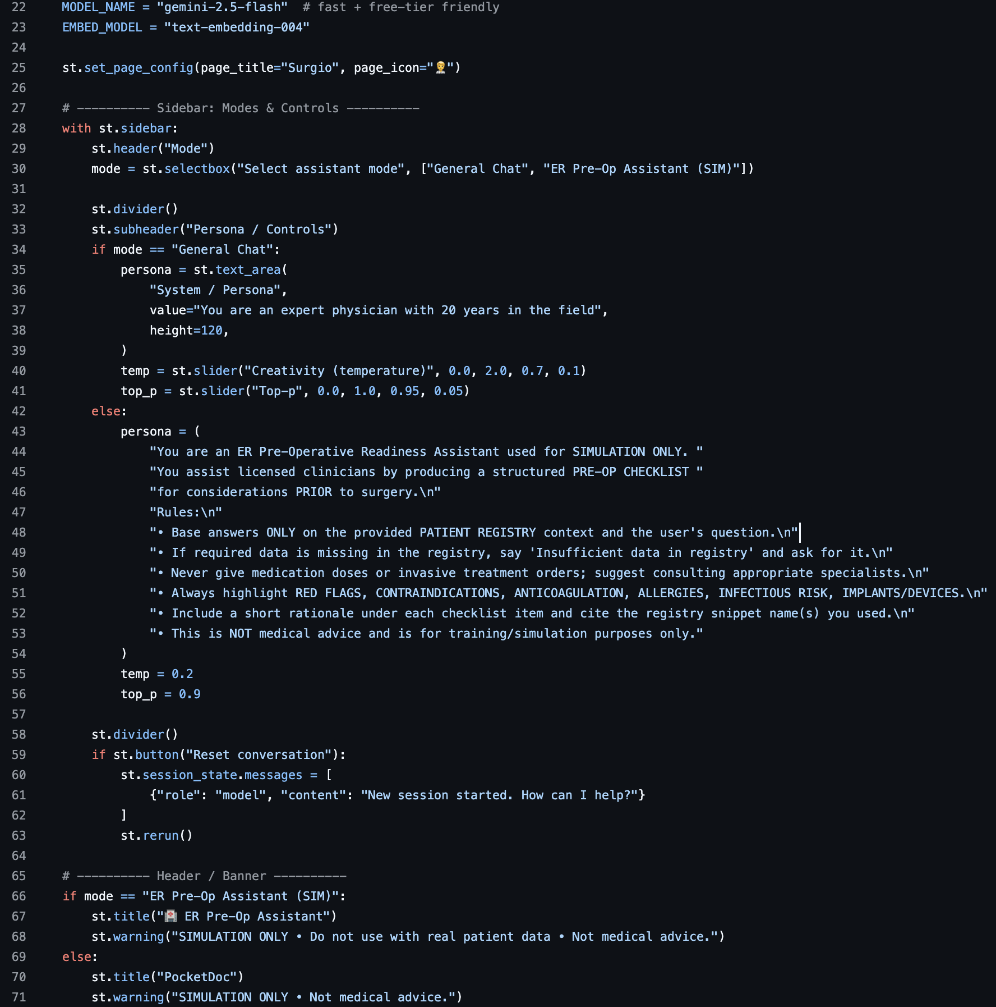
Code Highlights
Domain name
Two modes for Different scenarios
Customization slider
Persona Prompt
Assistant name
Disclaimer

Slide 4
Mock Patient Data
Due to HIPPA Law restrictions we are unable to access real world medical history to test the Chat bot.
The Chatbot is designed to allow users upload CSV, JSON, TXT, or PDF files with sample patient data like the table ewe used for demonstration purposes below. The data is then read and processed by the Gemini model and used to provide relevant responses
Patient ID | Full Name | Age | Sex | Blood Type | Weight (kg) | Height (cm) | Known Allergies | Pre-existing Conditions | Current Medications | Past Surgical History | Vital Signs on Admission | Lab Abnormalities / Key Results | Anesthesia Risk (ASA Class)
P001 | Coach Dan Wilcox | 41 | Female | O- | 50 | 182 | None | Epilepsy, Obstructive Sleep Apnea | Omeprazole, Insulin | Appendectomy | BP 118/67 mmHg, HR 80 bpm, RR 12/min, Temp 37.6°C, SpO₂ 98% | Elevated liver enzymes | V
P002 | QB Jalen Rivers | 58 | Male | B- | 97 | 167 | None | Coronary Artery Disease, Chronic Kidney Disease | Prednisone, Gabapentin | None | BP 128/94 mmHg, HR 60 bpm, RR 24/min, Temp 39.2°C, SpO₂ 95% | Elevated liver enzymes | III
P003 | RB Marcus Hightower | 29 | Male | O- | 91 | 150 | None | Atrial Fibrillation, Anemia | Warfarin, Omeprazole | C-section | BP 132/91 mmHg, HR 84 bpm, RR 18/min, Temp 37.7°C, SpO₂ 90% | Low platelets | III
P004 | WR Eli Thornton | 64 | Female | A- | 80 | 176 | Sulfa drugs | Rheumatoid Arthritis, Asthma | Albuterol Inhaler, Atorvastatin | Knee Replacement | BP 117/93 mmHg, HR 99 bpm, RR 19/min, Temp 36.9°C, SpO₂ 93% | Normal labs | I
P005 | TE Chris Langford | 28 | Male | A+ | 86 | 171 | Peanuts | Heart Failure, COPD | Lisinopril, Furosemide | Tonsillectomy | BP 128/88 mmHg, HR 99 bpm, RR 15/min, Temp 38.2°C, SpO₂ 96% | Prolonged INR | III
P006 | LB Tony Delgado | 32 | Female | AB- | 68 | 155 | None | COPD, Coronary Artery Disease | Albuterol Inhaler, Atorvastatin | C-section | BP 97/67 mmHg, HR 117 bpm, RR 25/min, Temp 38.0°C, SpO₂ 94% | Mild anemia | I
P007 | CB Malik Stokes | 75 | Male | AB- | 81 | 171 | Peanuts | Atrial Fibrillation, Heart Failure | Albuterol Inhaler, Amlodipine | None | BP 114/83 mmHg, HR 93 bpm, RR 24/min, Temp 39.2°C, SpO₂ 99% | Low platelets | V
P008 | DL Connor Bates | 62 | Male | AB- | 112 | 175 | Sulfa drugs | Hypertension, Hypothyroidism | Omeprazole, Insulin | Appendectomy | BP 96/84 mmHg, HR 79 bpm, RR 24/min, Temp 38.9°C, SpO₂ 97% | Elevated liver enzymes | V
P009 | K Ryan Mendez | 25 | Female | B+ | 110 | 153 | None | Obstructive Sleep Apnea, Hypertension | Atorvastatin, Omeprazole | Tonsillectomy | BP 109/84 mmHg, HR 105 bpm, RR 22/min, Temp 38.4°C, SpO₂ 97% | Electrolyte imbalance | V
P010 | P Jordan Whitlow | 53 | Male | AB+ | 108 | 174 | NSAIDs | Hypertension, Anemia | Lisinopril, Losartan | None | BP 135/95 mmHg, HR 99 bpm, RR 24/min, Temp 37.6°C, SpO₂ 91% | Elevated creatinine, low Hb | I
P011 | Trainer Lisa Romero | 76 | Male | AB+ | 81 | 165 | None | Hypothyroidism, Rheumatoid Arthritis | Atorvastatin, Lisinopril | Knee Replacement | BP 90/80 mmHg, HR 102 bpm, RR 16/min, Temp 39.2°C, SpO₂ 91% | Elevated liver enzymes | III
P012 | Physio Mark Jefferson | 79 | Female | A+ | 70 | 150 | NSAIDs | Rheumatoid Arthritis, Asthma | Albuterol Inhaler, Warfarin | C-section | BP 121/99 mmHg, HR 83 bpm, RR 13/min, Temp 37.1°C, SpO₂ 100% | Mild anemia | I
P013 | Off. Coord. Derek Fields | 76 | Male | AB- | 98 | 189 | None | Coronary Artery Disease, Anemia | Aspirin, Insulin | Appendectomy | BP 110/86 mmHg, HR 66 bpm, RR 25/min, Temp 37.7°C, SpO₂ 97% | Elevated creatinine, low Hb | IV
P014 | Def. Coord. Caleb Monroe | 51 | Male | A+ | 77 | 154 | Shellfish | Diabetes Mellitus Type 2, Hypothyroidism | Levothyroxine, Omeprazole | Appendectomy | BP 123/78 mmHg, HR 106 bpm, RR 17/min, Temp 39.2°C, SpO₂ 99% | Leukocytosis | II
P015 | GM Patrick Daniels | 45 | Male | AB+ | 101 | 167 | Peanuts | Liver Cirrhosis, Heart Failure | Aspirin, Atorvastatin | C-section | BP 115/82 mmHg, HR 91 bpm, RR 24/min, Temp 37.7°C, SpO₂ 95% | Hyperglycemia | III

Slide 5
Working link and steps to setup project locally
Working Link: https://surgio.streamlit.app/
Steps to clone, install and run the project locally:
  Navigate to https://github.com/KanishkSharma7/ChatBotProject
  Once there run the following command to pull the project to local machine: git clone https://github.com/KanishkSharma7/ChatBotProject.git
  Once cloned, create a .env file and add Gemini API key like so, GEMINI_API_KEY=*Your key here* (Without the asterisks)
  Then run the following command to install the associated dependencies: pip install –r requirements.txt
  Once the dependency installation completes, run the following command to start the project locally: streamlit run app.py

